Slide 1
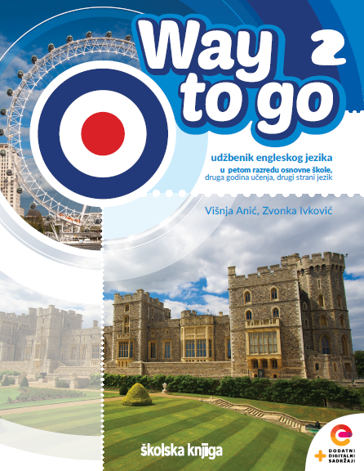

UNIT 1: Time for school
Windsor – a small town near London

Slide 2
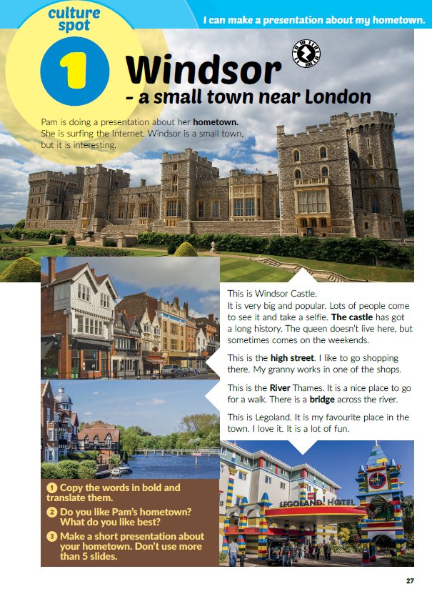
Why is your hometown special / popular?
Are there any famous building in your town?
Are there any famous people from your town?
Open your book at page 27.
Do you remember where Pam lives?
Is it a small or a big town?
Where else can people live?
Read the text. Do you know what the words in bold mean?
Read the text again. What do you like best about Pam’s hometown?
Compare Pam’s and your own hometown.

Slide 3

Work in groups. Make a short presentation about your hometown. You can surf the Net to find more information about your hometown. Talk about your hometown and explain which sights you chose to present and why.
Click on the following link and choose ‘‘Self check”. Complete the tasks.
Then, choose ‘‘Learn more” and read the texts The British Royal Family and Where we live.
https://www.e-sfera.hr/dodatni-digitalni-sadrzaji/ea9258d0-a09f-4ffc-85c8-cff30f6dc331/

